Slide 1


Axion-Like Particles at the ILC Giga-Z
Noah Steinberg
Pikimo 10 – April 10th
arXiv:2101.00520v1 [hep-ph]

Slide 2
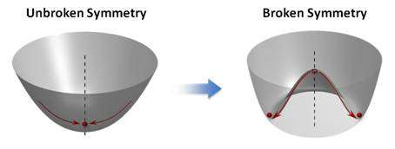


Axion Like Particles (ALPs)
Generic pseudo-scalar
Shows up as pseudo-nambu goldstone boson from SSB
Axion, majaron, familion, etc..
Couple to two gauge bosons and possibly to SM fermions
Couplings and mass not directly related like QCD axion (enlarged parameter space)
Complementary search direction for weakly coupled new physics with masses near or below EW scale

Slide 3
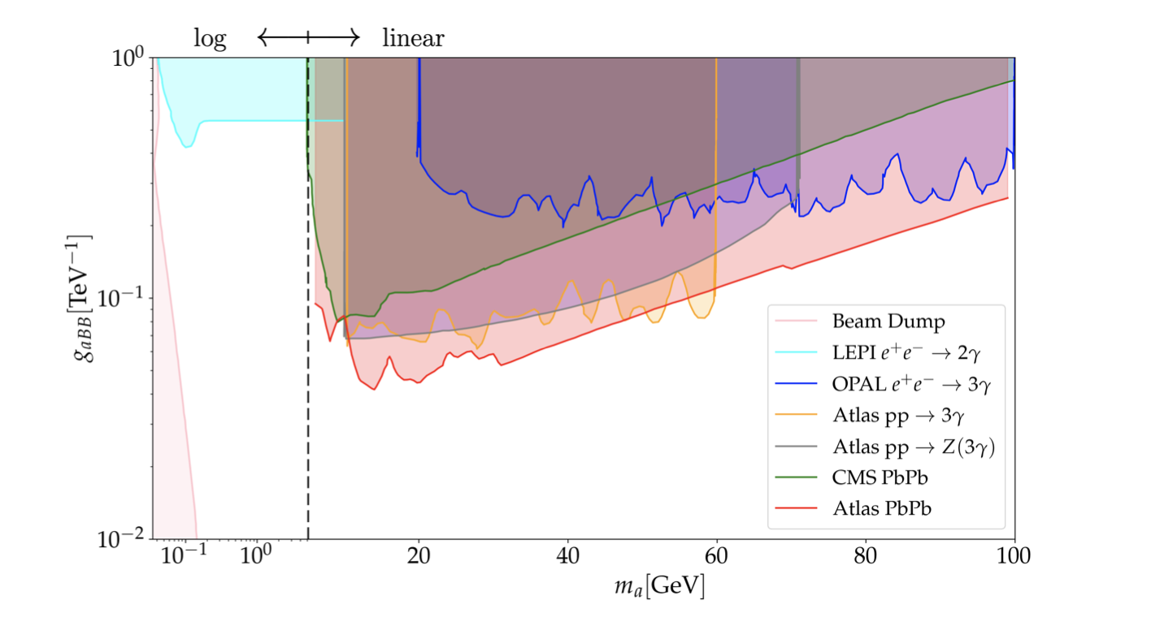
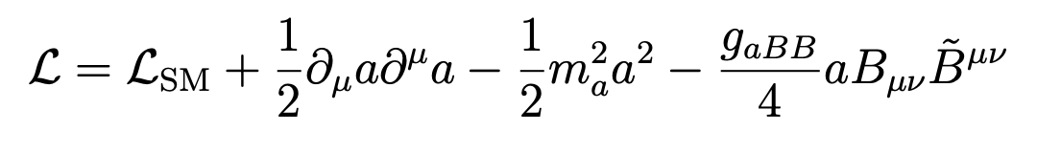
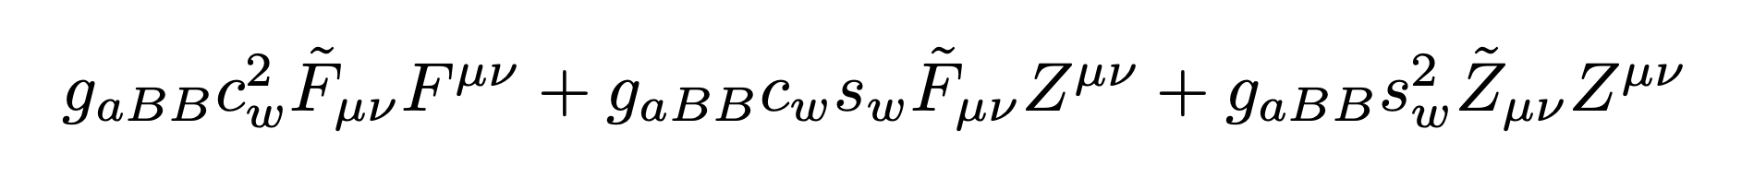
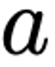

Coupling to Hypercharge
For the sake of simplicity, assume that ALP couples only to hypercharge
Below EW scale this leads to three operators
ALP couples to $γγ, γZ, ZZ$
Many probes of this model, depending on ALP mass, $m_{a}$ and $g_{aBB}$
Focus on region between 1 and 100 GeV
Collider probes become most important
( )
arXiv:2101.00520

Slide 4
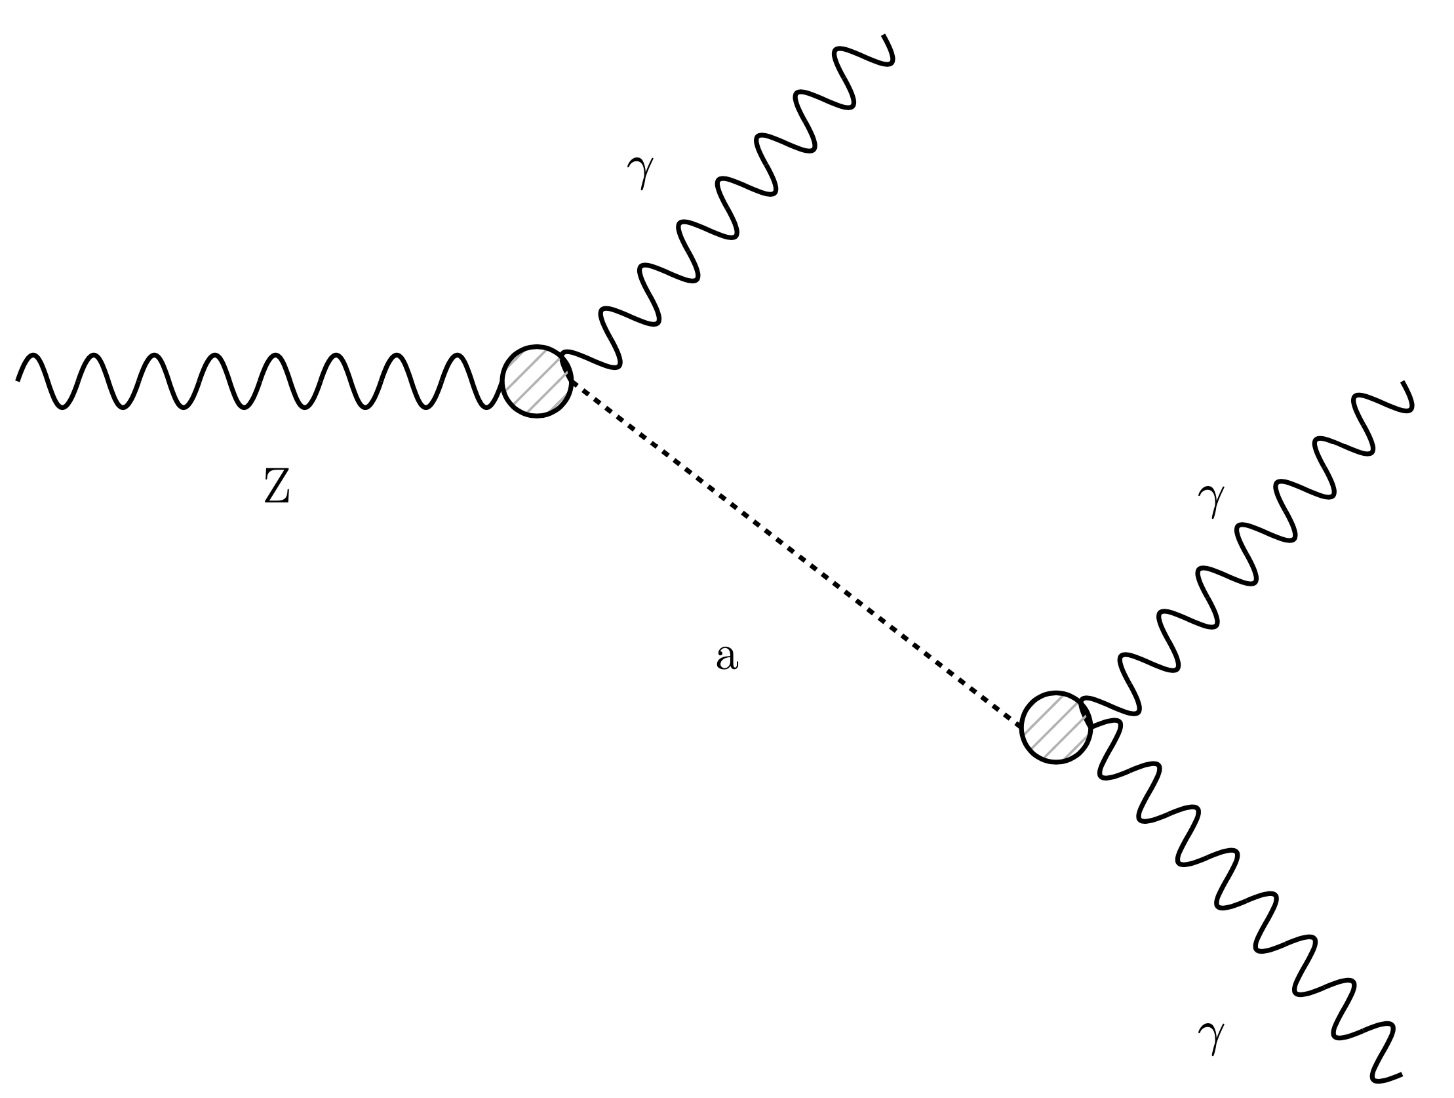
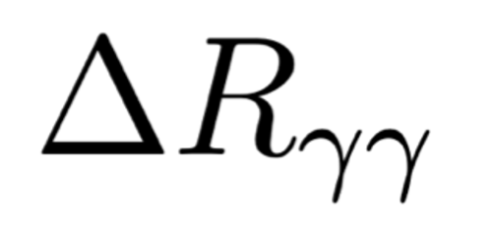
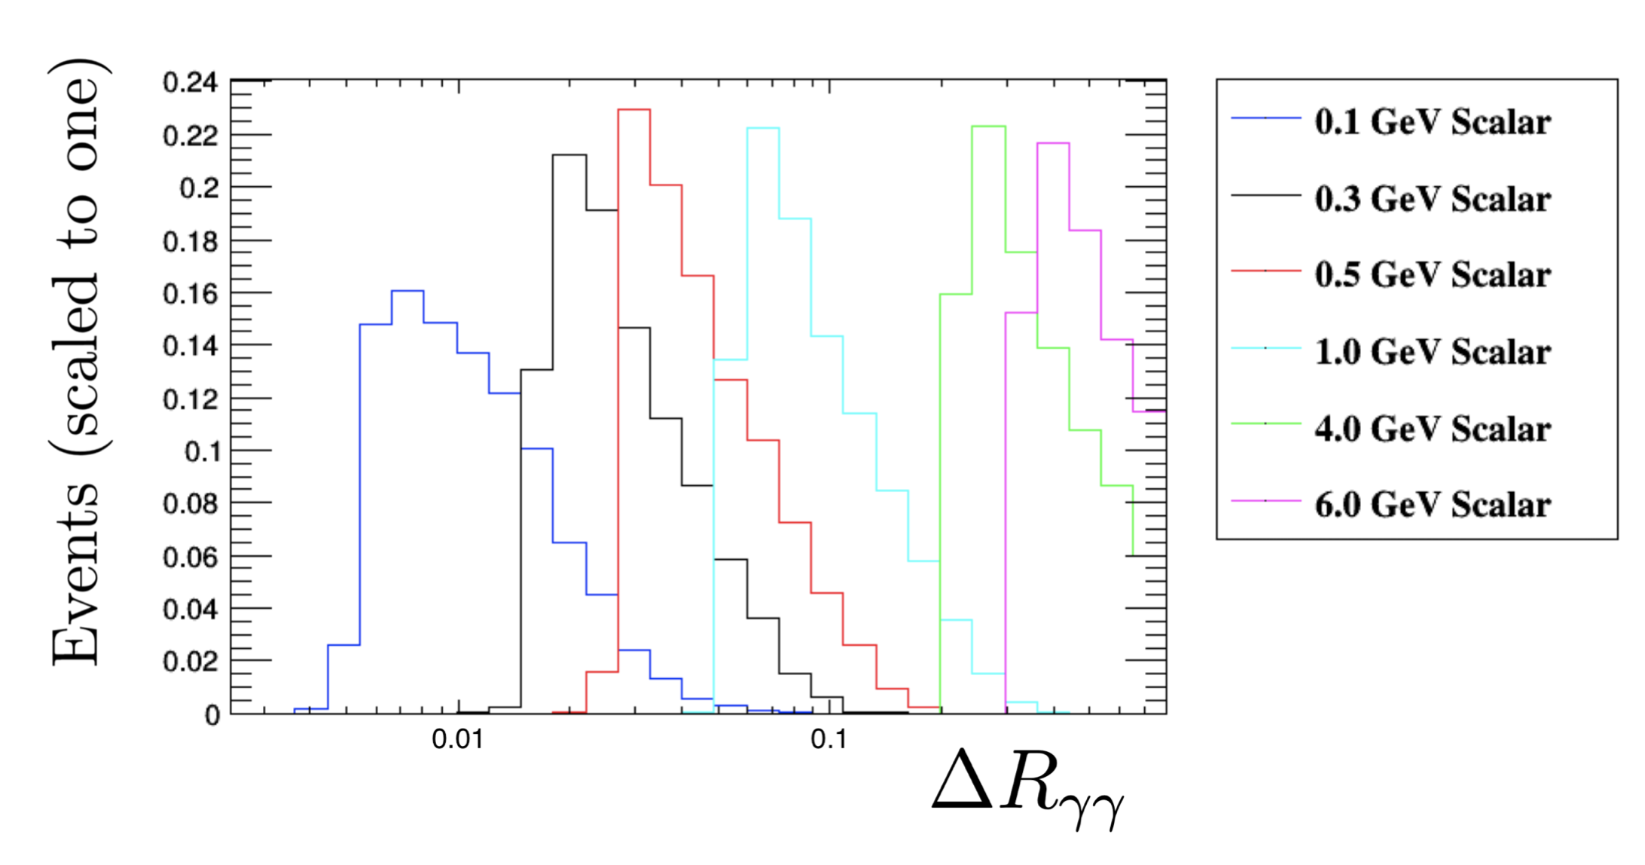
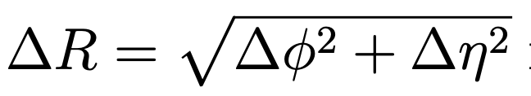
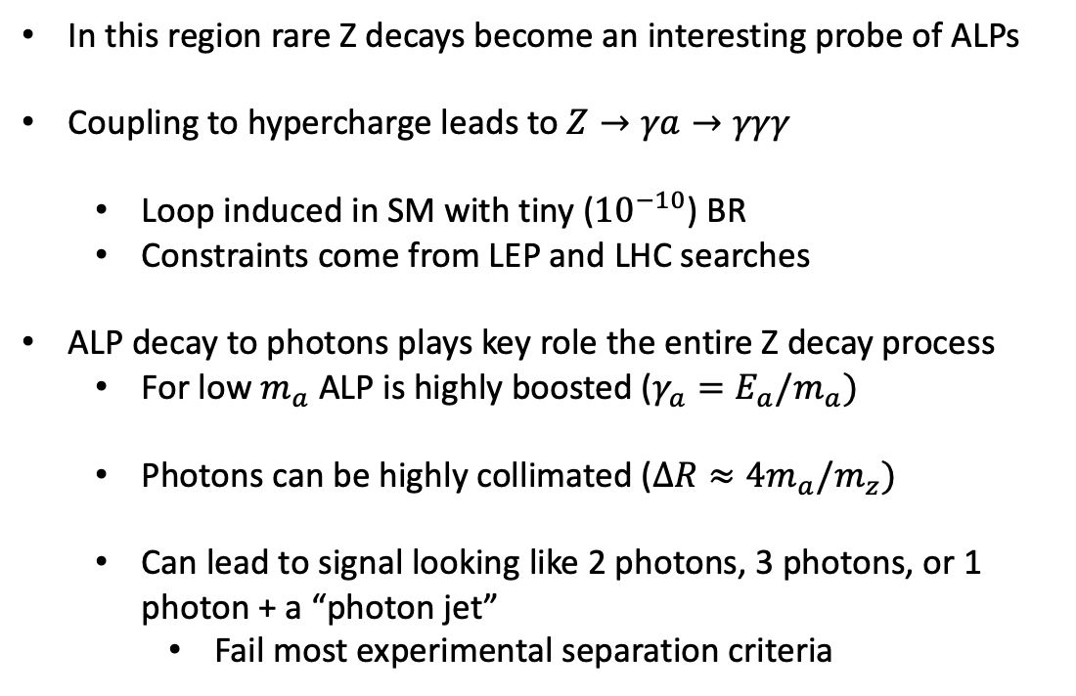
Rare Z Decays and Boosted ALPS
In this region rare Z decays become an interesting probe of ALPs
Coupling to hypercharge leads to $Z→γa→γγγ$
Loop induced in SM with tiny (${10}^{−10}$) BR
Constraints come from LEP and LHC searches
ALP decay to photons plays key role the entire Z decay process
For low $m_{a}$ ALP is highly boosted ($γ_{a}=E_{a}/m_{a})$
Photons can be highly collimated ($ΔR≈4m_{a}/m_{z})$
Can lead to signal looking like 2 photons, 3 photons, or 1 photon + a “photon jet”
Fail most experimental separation criteria

Slide 5
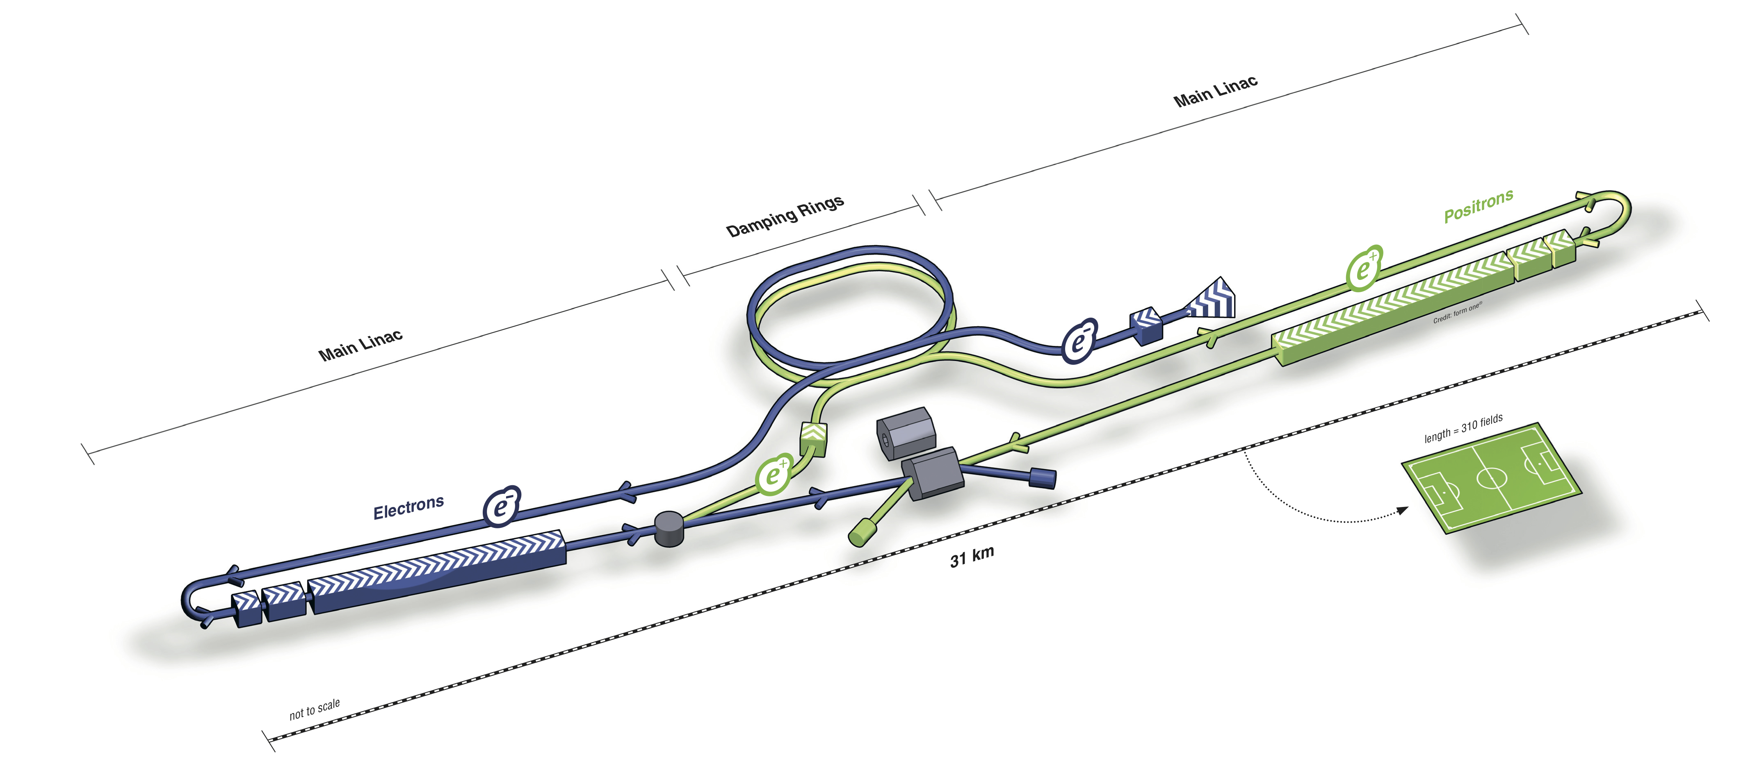
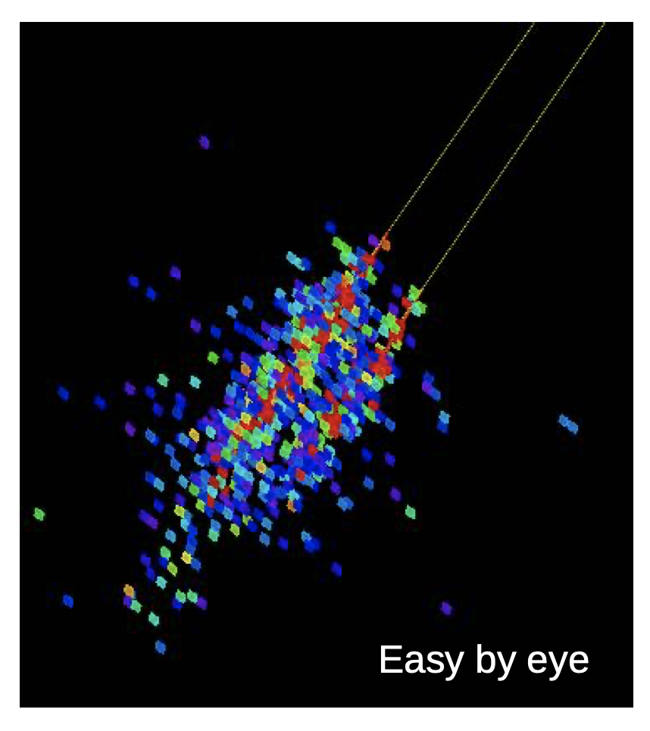
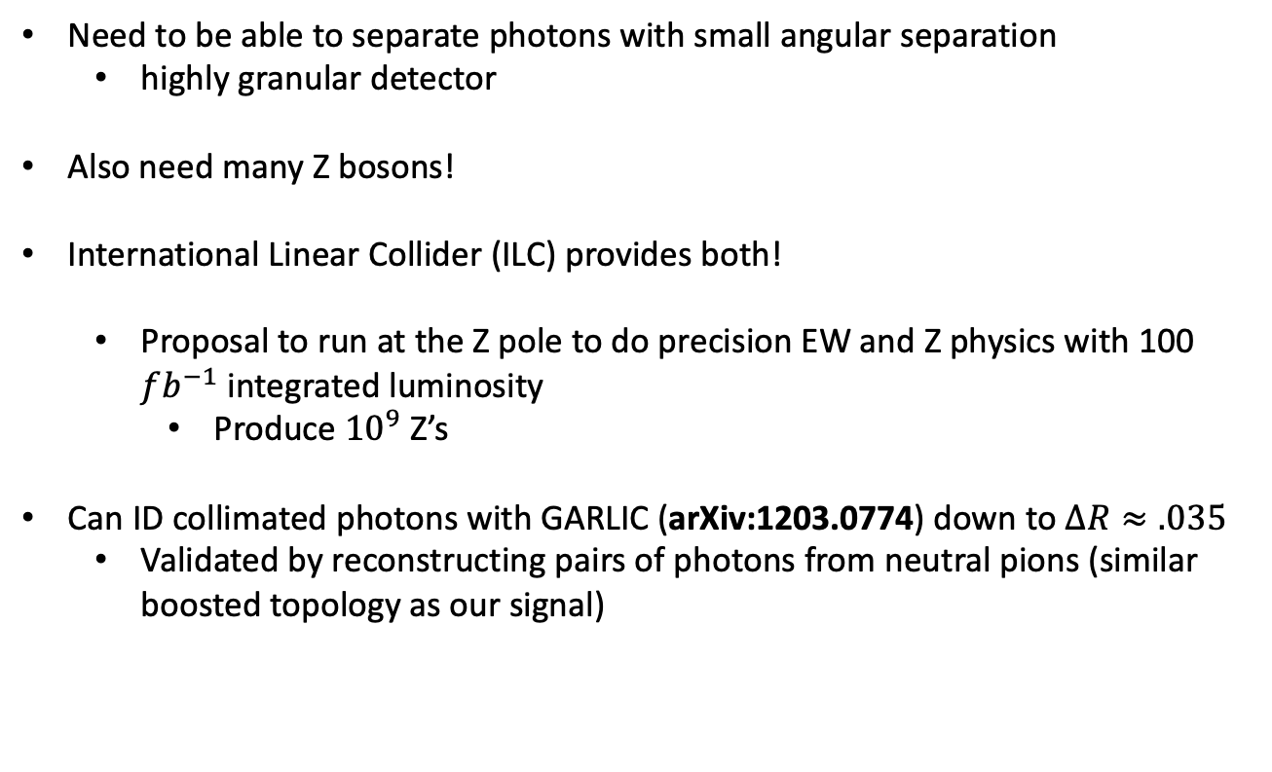
ILC-Giga Z
Need to be able to separate photons with small angular separation
highly granular detector
Also need many Z bosons!
International Linear Collider (ILC) provides both!
Proposal to run at the Z pole to do precision EW and Z physics with 100 $fb^{−1}$ integrated luminosity
Produce ${10}^{9}$ Z’s
Can ID collimated photons with GARLIC (arXiv:1203.0774) down to $ΔR≈.035$
Validated by reconstructing pairs of photons from neutral pions (similar boosted topology as our signal)
arXiv:1903.01629
arXiv:0005024
Two photons from 30 GeV Pi0
https://indico.in2p3.fr/event/11192/contributions/4601/attachments/3966/5002/llr_meeting_2015.pdf

Slide 6
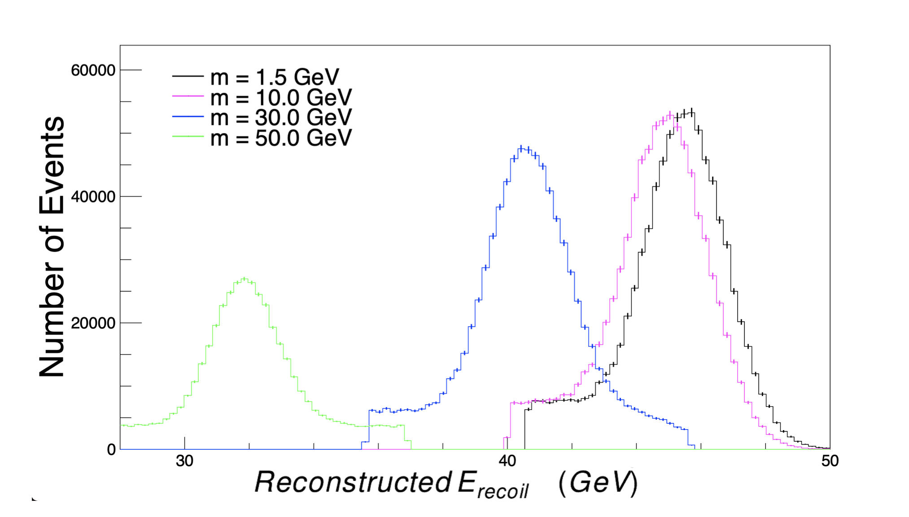
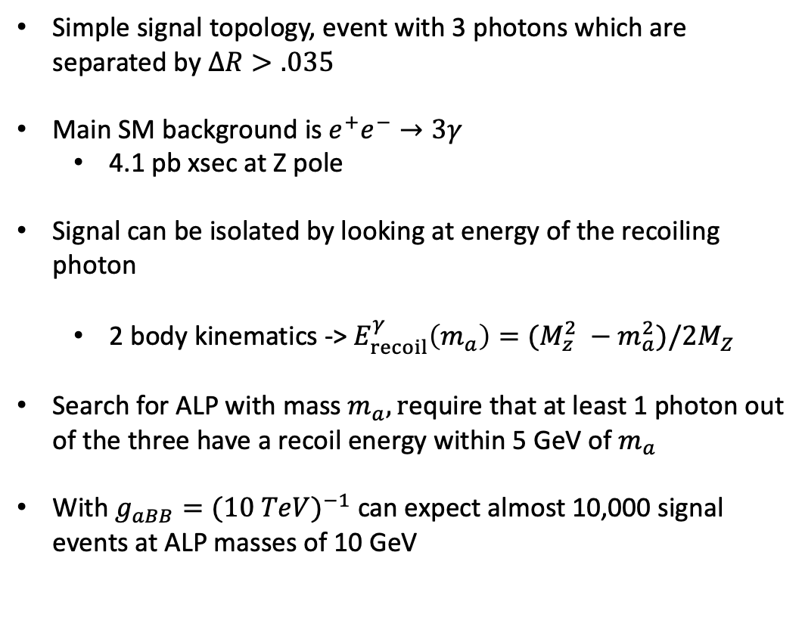
Signal selection and Backgrounds
Simple signal topology, event with 3 photons which are separated by $ΔR>.035$
Main SM background is $e^{+}e^{−}→3γ$
4.1 pb xsec at Z pole
Signal can be isolated by looking at energy of the recoiling photon
2 body kinematics -> $E_{recoil}^{γ}\left(m_{a}\right)=(M_{z}^{2} −m_{a}^{2})/2M_{Z}$
Search for ALP with mass $m_{a}, r$equire that at least 1 photon out of the three have a recoil energy within 5 GeV of $m_{a}$
With $g_{aBB}=(10 Te{V)}^{−1}$ can expect almost 10,000 signal events at ALP masses of 10 GeV

Slide 7
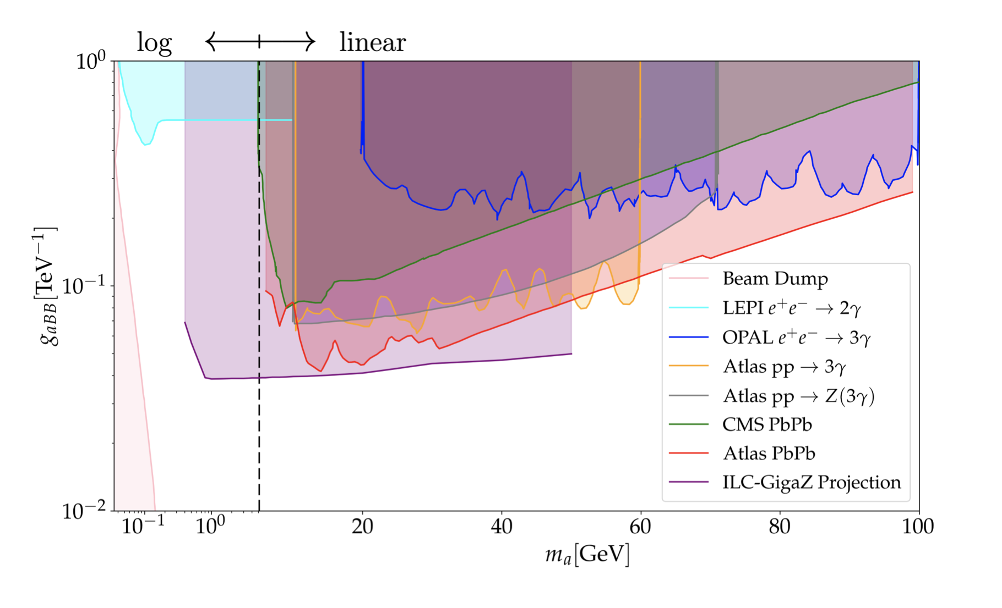

Constraints on $m_{a}, g_{aBB}$
At 95% confidence level, ILC will be able to place constraints on this ALP model down to (50 TeV)^-1 from 0.4 to 50 GeV
Order of magnitude better than LEP in the the 1 – 10 GeV region
Slightly better or similar reach as UPC at LHC
Can refine search further for low mass ALPs (< 20 GeV) by requiring two photons with a small separation
Backgrounds fall quickly in this region
Also for very small masses can look for highly collimated photons that appear as a single photon and use shower shape variables
Ellis – arXiv:1210.3657
arXiv:2101.00520

Slide 8
Thank you! Questions?

